Slide 1

Protecting Yourself From Phishing: A Complete Guide
In today's digital age, phishing attacks have become increasingly sophisticated, posing a significant threat to individuals and organizations alike. This presentation serves as a comprehensive guide to understanding, recognizing, and preventing phishing attempts. We will explore various types of phishing, learn how to identify red flags, implement best practices for prevention, and understand the steps to take if you've been phished. Let's dive into the world of cybersecurity and arm ourselves against these malicious attacks.
by Dilsara Sandun

Slide 2
What is Phishing? Understanding the Digital Threat
Definition
Motivation
Why it Matters
Phishing is a type of online fraud where attackers impersonate legitimate entities to trick individuals into revealing sensitive information, such as usernames, passwords, and credit card details.
The primary goal of phishing is to steal personal data for financial gain or identity theft. Attackers often use this information to access bank accounts, make unauthorized purchases, or commit other fraudulent activities.
Understanding phishing is crucial because it can affect anyone. By being informed and vigilant, you can significantly reduce your risk of falling victim to these scams.
Phishing attacks can have devastating consequences, both personally and professionally. Stay informed and stay safe!

Slide 3
Types of Phishing Attacks
1. Social Engineering - On your Facebook profile or LinkedIn profile, you can find: Name, Date of Birth, Location, Workplace, Interests, Hobbies, Skills, your Relationship Status, Telephone Number, Email Address and Favorite Food. This is everything a Cybercriminal needs in order to fool you into thinking that the message or email is legitimate.
2. Link Manipulation - Most methods of phishing use some form of deception designed to make a link in an email appear to belong to the spoofed organization or person. Misspelled URLs or the use of subdomains are common tricks used by phishers. Many email clients or web browsers will show previews of where a link will take the user in the bottom left of the screen or while hovering the mouse cursor over a link.

Slide 4
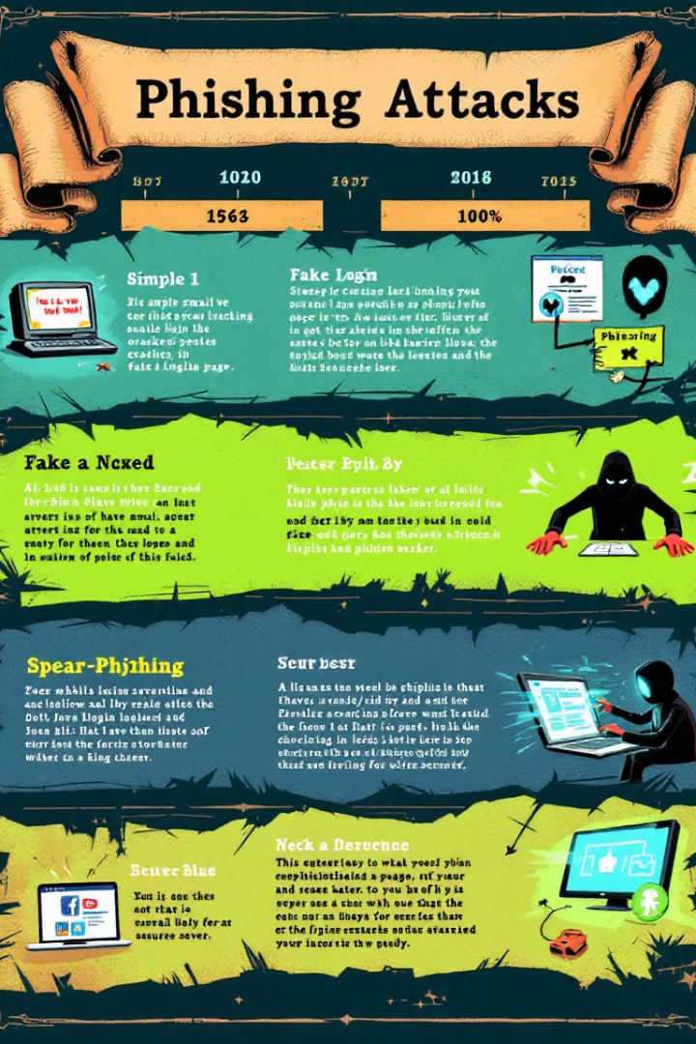
The Evolution and Impact of Phishing Attacks
1
Early Phishing (1990s)
Simple email scams targeting AOL users.
2
Sophistication (2000s)
More realistic emails mimicking banks and financial institutions.
3
Targeted Attacks (2010s)
Spear phishing and whaling targeting specific individuals.
4
AI-Powered Phishing (2020s)
AI and machine learning used to create highly personalized attacks.
Phishing attacks have evolved dramatically over the decades, becoming more sophisticated and harder to detect. Initially, these scams were simple and easy to spot, but as technology advanced, so did the techniques used by cybercriminals. Today, AI-powered phishing attacks can mimic legitimate communications with alarming accuracy, making it crucial to stay informed and vigilant.

Slide 5




Common Types: Email Phishing, Spear Phishing, and Smishing
Email Phishing
Spear Phishing
Smishing
Mass emails disguised as legitimate communications from trusted sources.
Targeted emails aimed at specific individuals or organizations.
Phishing attacks conducted through SMS or text messages.
Phishing comes in various forms, each with its own unique approach. Email phishing involves mass emails designed to trick recipients into divulging personal information. Spear phishing is more targeted, focusing on specific individuals or organizations. Smishing uses SMS or text messages to lure victims into clicking malicious links or providing sensitive data.

Slide 6
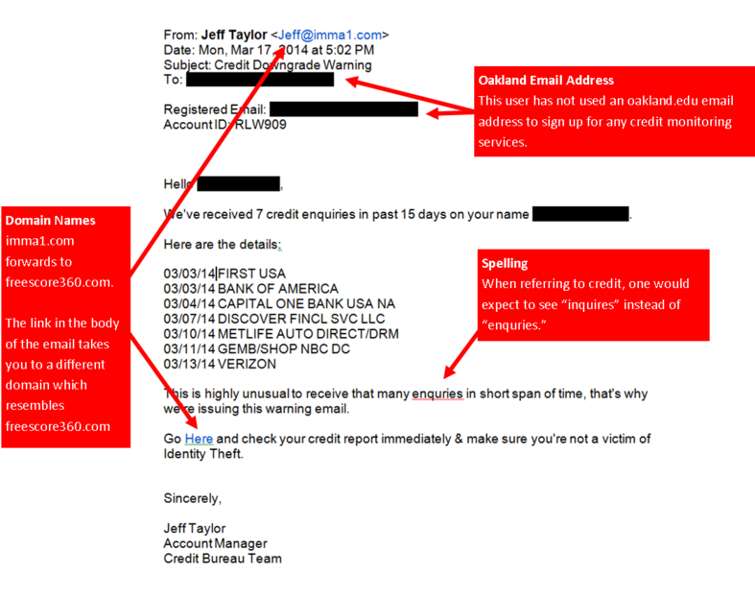
PHISHING E-MAIL EXAMPLE AND TIPS
Unfortunately, there is no one single technique that works in every situation, but there are a number of things that you can look for.
1: The message contains a mismatched URL
Oftentimes the URL in a phishing message will appear to be perfectly valid. However, if you hover your mouse over the top of the URL, you should see the actual hyperlinked address (at least in Outlook).
2: URLs contain a misleading domain name
People who launch phishing scams often depend on their victims not knowing how the DNS naming structure for domains works. The last part of a domain name is the most telling.
3: The message contains poor spelling and grammar
Whenever a large company sends out a message on behalf of the company as a whole, the message is usually reviewed for spelling, grammar, and legality, among other things.
4: The message asks for personal information
No matter how official an email message might look, it's always a bad sign if the message asks for personal information. Your bank doesn't need you to send it your account number. It already knows what that is.

Slide 7
Red Flags: How to Identify Suspicious Messages
Generic Greetings
Spelling and Grammar Errors
Be wary of emails that start with "Dear Customer" or "Dear User" instead of your name.
Poorly written emails with typos or grammatical mistakes are often phishing attempts.
Urgent Requests
Suspicious Links
Phishing emails often create a sense of urgency to pressure you into acting quickly.
Hover over links to check the actual URL and avoid clicking on anything unfamiliar.
Identifying red flags is crucial in detecting phishing attempts. Look out for generic greetings, spelling and grammar errors, urgent requests, and suspicious links. These signs can help you distinguish between legitimate communications and malicious phishing scams. Always exercise caution and verify the authenticity of any message before taking action.

Slide 8
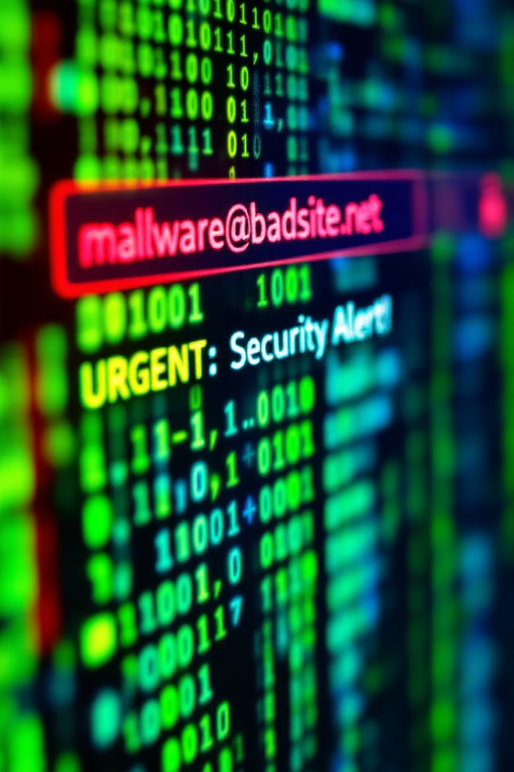



Technical Safeguards: Checking Sender Details and URLs
Verify Sender Address
Check the sender's email address to ensure it matches the purported organization.
Inspect URLs
Hover over links to preview the actual URL before clicking.
Use Security Tools
Utilize antivirus software and browser extensions to block phishing sites.
Technical safeguards can provide an additional layer of protection against phishing attacks. Always verify the sender's email address to ensure it matches the purported organization. Inspect URLs by hovering over links to preview the actual destination. Utilize security tools such as antivirus software and browser extensions to block known phishing sites.

Slide 9
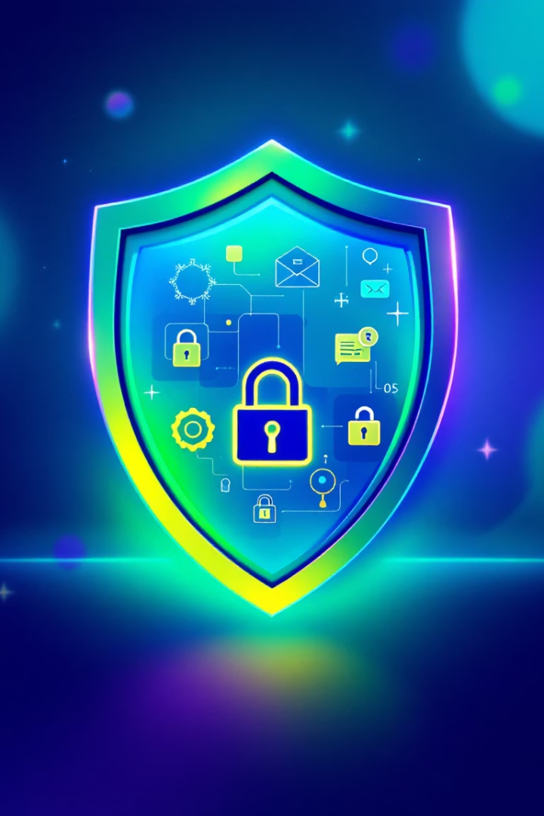
Best Practices for Phishing Prevention
Never Click Unknown Links
Verify Requests
Avoid clicking on links in emails or messages from unknown sources.
Confirm any requests for personal information by contacting the organization directly.
Enable Two-Factor Authentication
Add an extra layer of security to your accounts.
Implementing best practices is essential for effective phishing prevention. Never click on links in emails or messages from unknown sources. Verify any requests for personal information by contacting the organization directly. Enable two-factor authentication to add an extra layer of security to your accounts.

Slide 10
TIPS ON STAYING SAFE
Keep Informed About Phishing Techniques - New phishing scams are being developed all the time. Without staying on top of these new phishing techniques, you could inadvertently fall prey to one. Keep your eyes peeled for news about new phishing scams. By finding out about them as early as possible, you will be at much lower risk of getting snared by one.
Think Before You Click! - A phishing email may claim to be from a legitimate company and when you click the link to the website, it may look exactly like the real website. The email may ask you to fill in the information but the email may not contain your name.
Install an Anti-Phishing Toolbar - Most popular Internet browsers can be customized with anti-phishing toolbars. Such toolbars run quick checks on the sites that you are visiting and compare them to lists of known phishing sites. If you stumble upon a malicious site, the toolbar will alert you about it.
Verify a Site’s Security - As long as you are on a secure website, however, you shouldn’t run into any trouble. Before submitting any information, make sure the site’s URL begins with “https” and there should be a closed lock icon near the address bar.
Check Your Online Accounts Regularly - If you don’t visit an online account for a while, someone could be having a field day with it. To prevent bank phishing and credit card phishing scams, you should personally check your statements regularly. Get monthly statements for your financial accounts and check each and every entry carefully to ensure no fraudulent transactions have been made without your knowledge.

Slide 11
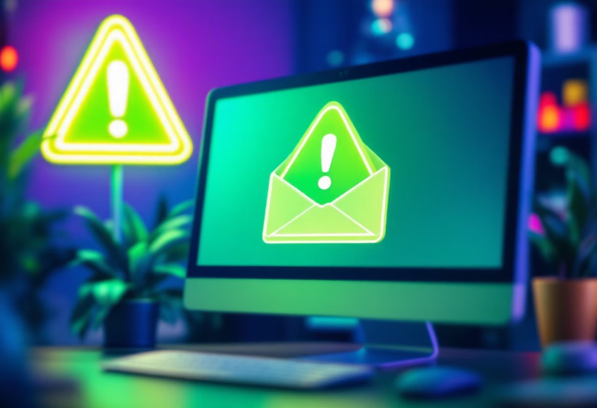

Real-World Examples: Anatomy of Actual Phishing Attempts
Fake Bank Email
Malicious Website
A phishing email disguised as a legitimate communication from a bank, asking users to update their login details.
A fake website mimicking a popular online store, designed to steal credit card information.
Examining real-world examples of phishing attempts can provide valuable insights into the tactics used by cybercriminals. Fake bank emails and malicious websites are common methods used to deceive victims into divulging personal information. By understanding these examples, you can better recognize and avoid falling for similar scams.

Slide 12

What to Do If You've Been Phished
Change Passwords
Immediately change passwords for all affected accounts.
Contact Institutions
Notify your bank or other relevant institutions.
Report the Incident
Report the phishing attempt to the authorities and relevant organizations.
If you suspect you've been phished, take immediate action to mitigate the damage. Change passwords for all affected accounts, notify your bank or other relevant institutions, and report the incident to the authorities and relevant organizations.

Slide 13



Key Takeaways and Creating a Culture of Security
Vigilance
1
Stay alert and cautious.
Education
2
Continuous learning.
Prevention
3
Proactive measures.
In conclusion, protecting yourself from phishing requires a combination of vigilance, education, and proactive measures. Stay alert and cautious when handling online communications, continuously educate yourself on the latest phishing techniques, and implement preventive measures such as two-factor authentication. By fostering a culture of security, we can collectively reduce the risk of falling victim to these malicious attacks.

Slide 14
Additional Resources.
http://www.antiphishing.org / http:// www.fraudwatchinternational.com/phishing-alerts
http://phishme.com
http:// www.onguardonline.gov/phishing
http:// www.consumer.ftc.gov/articles/0076-phone-scams
http:// www.fbi.gov/scams-safety/fraud Sources
http://phishme.com/phishing-social-media-infographic/
http://en.wikipedia.org/wiki/Phishing
http://www.onguardonline.gov/phishing

